Slide 1
How Much is a Data Science Job Candidate Worth?
By Laura Gascue

Slide 2
Diversity in the DS/ML Field
Experienced data scientists coexist with a large number of recent graduates
Large number of tools requiring diverse skills:
Data visualization libraries,
ML Frameworks and algorithms,
computer vision methods,
natural language processing (NLP)
Multiple programming languages
Python, R, C/C++, Java/Javascript, Julia, Swift, etc.
Data Scientists and related positions:
Data Scientist, Data Engineer, DBA/Database Engineer, Research Scientist, Machine Learning Engineer, Statistician, Business Analyst, Data Analyst

Slide 3
Data Sources
Kaggle 2021 Data Science and Machine Learning (DS & ML) Survey
Distributed to the entire Kaggle community through e-mail, promoted via website and Twitter
Objective: picture of the state of the DS & ML field around the world
Question on yearly compensation, demographic characteristics, experience, skills and place of work
Supplemental sources
World Population Review
BLS - Occupational Employment and Wage Statistics

Slide 4
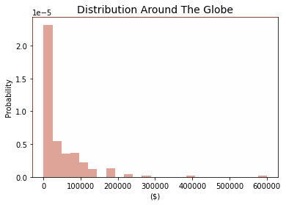
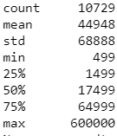
DS/ML Community - Salary Distribution
Occupation (SOC code) | Annual mean wage
Database Administrators and Architects(151245) | 101,090
Software Developers and Software Quality Assurance Analysts and Testers(151256) | 114,270
Mathematical Science Occupations(152000) | 99,700
Operations Research Analysts(152031) | 92,280
Statisticians(152041) | 97,170
Data Scientists and Mathematical Science Occupations, All Other(152098) | 103,930

Slide 5
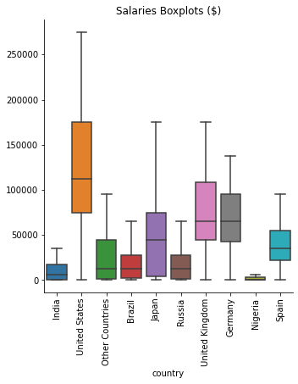
Distribution by Country - Top Respondents
Large disparities between countries
Large variation within countries

Slide 6
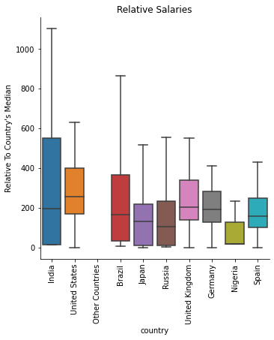
Distribution Relative to Country’s Median Household Income
Disparities less pronounced
Still large variation within countries
Salaries in the DS/ML community largely above country median

Slide 7
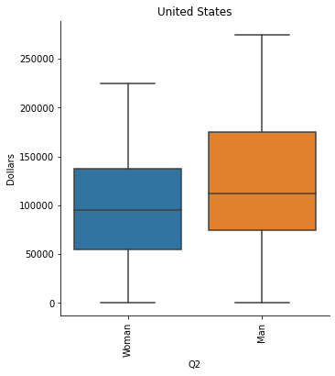
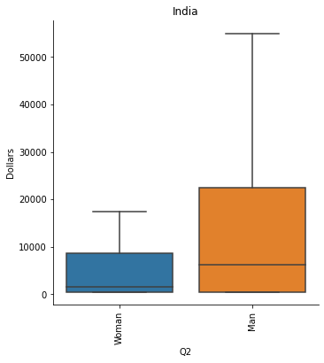
Gender Disparities
Large salary gap between men and women ($46K vs $33K, average around the world)
Gap present in US and India (top respondents, high and low end of income level)
US: $126K vs $97K
India: $21K vs 7K

Slide 8
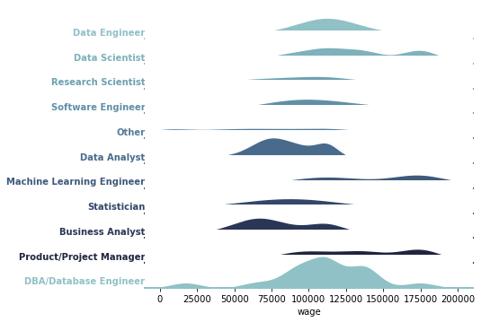
United States Salaries - By Job Title

Slide 9
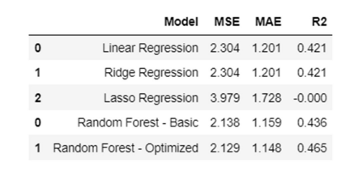
Modeling Salaries
Salaries transformed using natural logs
Features considered:
Demographics: age, gender, working and machine learning experience,
Geography: country of residence (indicator for top 10, and high, medium-high, medium-low, low income level indicators)
Job characteristics: job position, employer size
DS/ML tools: programming language used, use of visualization methods, computing platform (cloud, deep learning, computer/laptop), statistical software (advance, basic, BI, local development environments),
Models fit:
Linear Regression
Ridge Regression
Lasso Regression
Random Forest
Random Forest Optimized

Slide 10
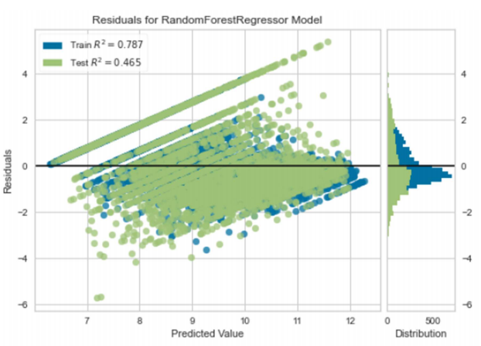
Final Model Fit
MAE ($): 29,854

Slide 11
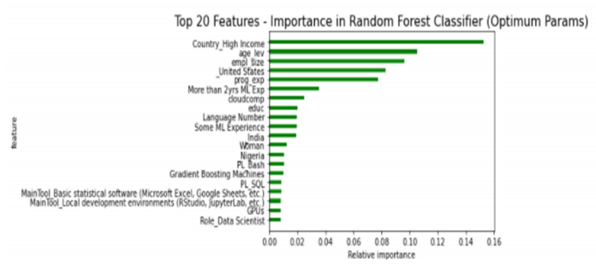
Most Important Features

Slide 12
Conclusions
DS/ML jobs are in general paid well above country’s median income
Gender gap in the sector is strong
Salaries have high level of variation, even within the same country and for the same job position
A Random Forest approach is preferable over a linear model type when predicting salaries
Top 10 features in explaining salaries (in order of importance: high income country, age, employer size, US resident, programming experience, more than 2 years of ML experience, cloud computing, education level, number of programming languages known, some ML experience
The Kaggle DS/ML survey provides with a rich dataset to analyze salaries in the sector, but it fall short to explain a large portion of salary differences
Two questions could be added to the survey to increase understanding on DS/ML sector salaries:
Employer’s industry
Position status (part-time, full time, free-lance, etc)

